Slide 1
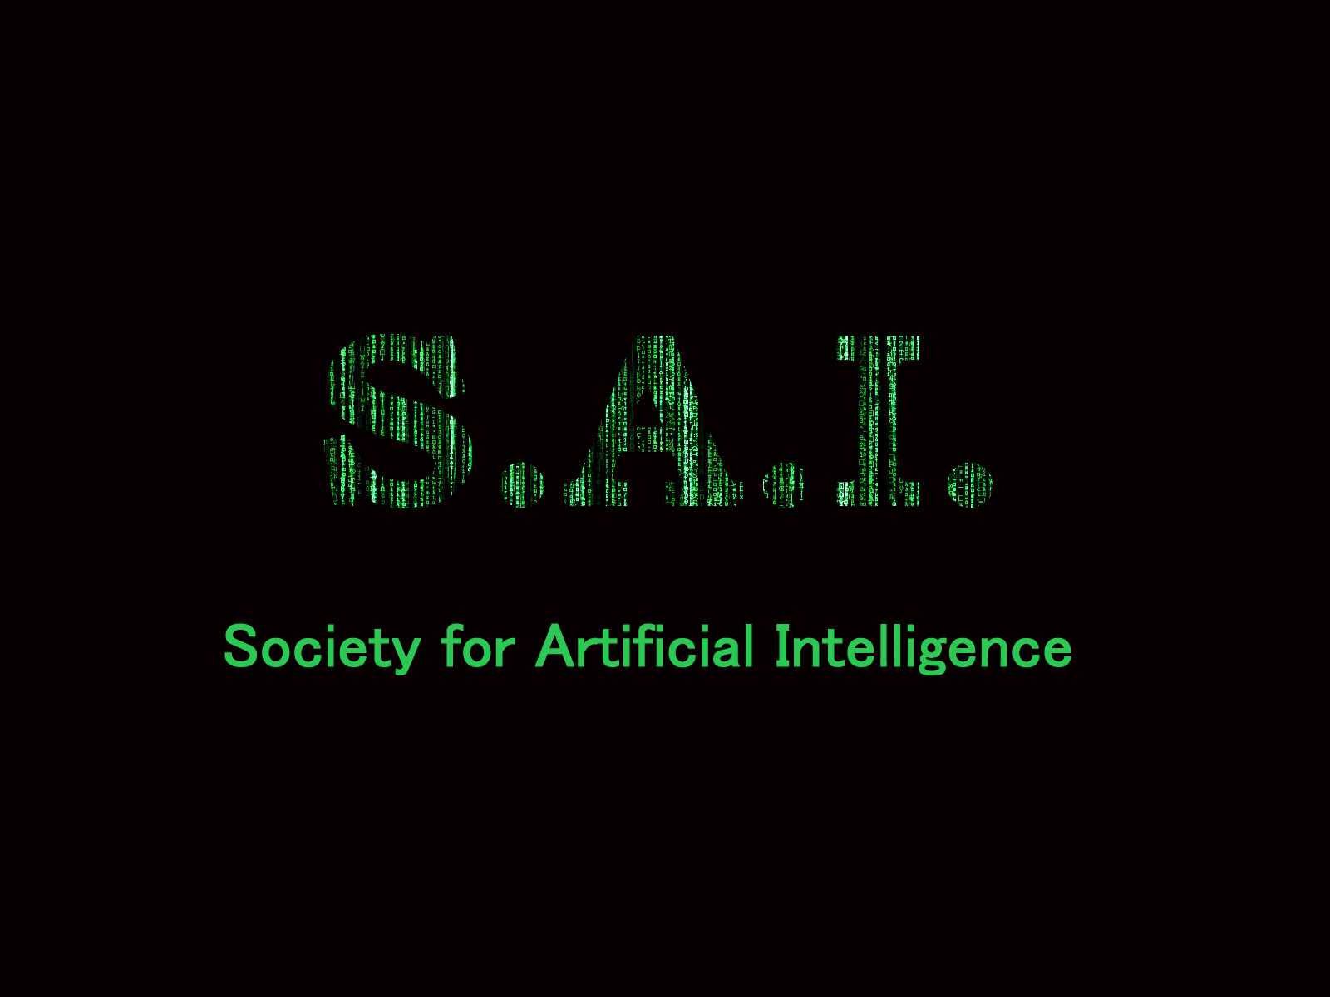
S.A.I. Society for Artificial Intelligence

Slide 2
Mission Statement
The core objective of the Society is to study the history of advances in the field of Artificial Intelligence as well as their modern implications.
Through the Society students will be able to:
Collaborate on projects involving the development of A.I. systems.
Study algorithms associated with A.I. operations and how to implement them in programming.
Keep current with trends in A.I. research and its modern impact on society.
Discuss methods of Machine Learning and the history of their development.
Explore fields of employment relating to different subsets of A.I.

Slide 3
A.I. Topics
Six main disciplines:
- Knowledge Representation
- Automated Reasoning
- Machine Learning
- Robotics
Comp. Linguistics (NLP)
Computer Vision
Other issues:
- Programming ethics into machines
- Turing Test
Tech. Singularity
- Artificial General
Intelligence (AGI)
- Philosophy of Consciousness
Machine Learning methods(Supervised, etc.)
Deep Learning

Slide 4
Game A.I. Development
Movement
Path Finding
Point system
Exploring / Patrolling
Decision-Making
Decision trees
Scripted-AI
Goal oriented
Strategy
Fuzzy logic
Resource management
Multi-Agent coordination

Slide 5
Milestones
Simple
Reflex
Agents
Utility-Based
Agents
Learning
Agents
Model-Based
Reflex
Agents
Goal-Based
Agents

